Slide 1
Soft skills and effective interpersonal communication

Slide 2
Effective Listening
A dynamic process.
It means attentiveness and interest perceptible in the posture as well as expressions.
Active process.
Physical and psychological efforts.

Slide 3
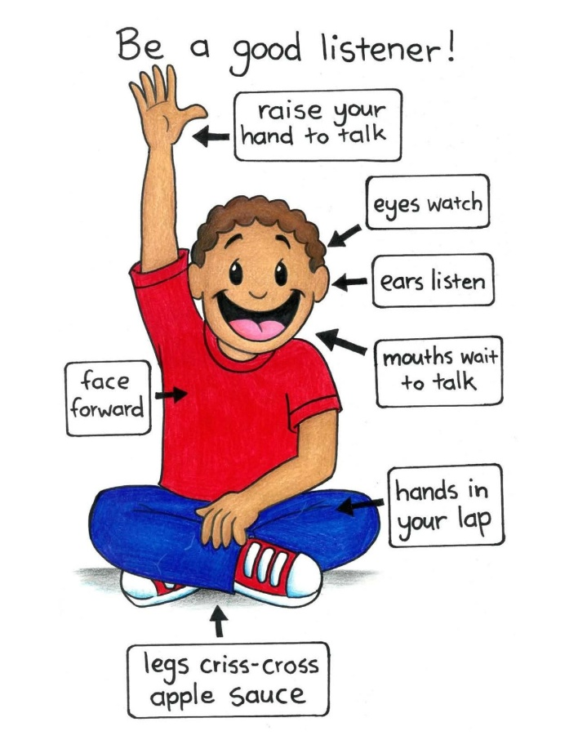
Features of good and effective listener
Attentive
Does not assume
Listen for feelings and facts
Concentrate on the other speakers kindly and generously
Opportunizes

Slide 4
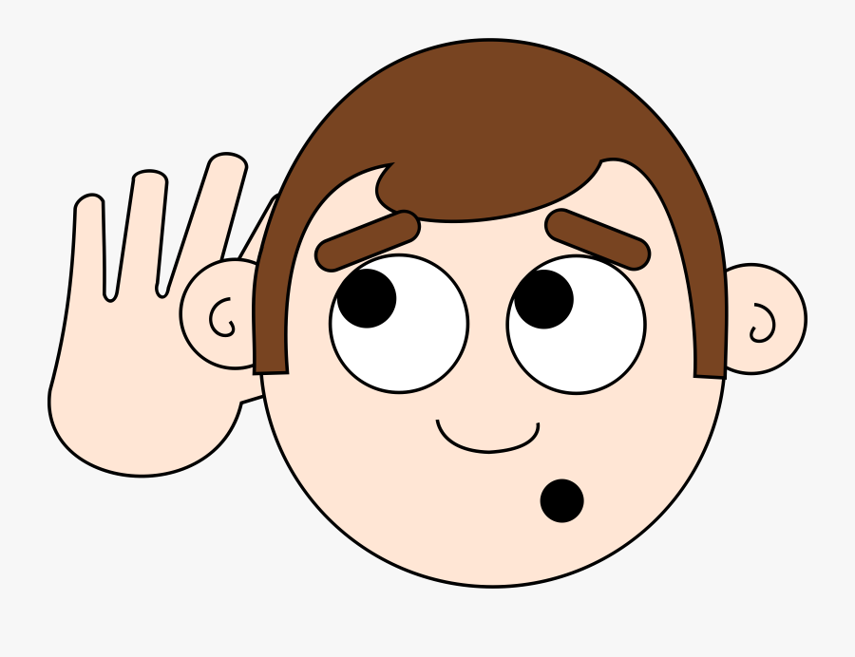
Steps for effective listening
Intend to listen
Be patient
Maintain eye contact
Identify emotions
Acknowledge the speaker
Show interest
What’s missing

Slide 5
Methods of communication
Verbal
Oral
Written
Non verbal
Kinesics (Body language)
Oculesics (Eye contact)
Haptics (Touch)
Proxemics (Space)
Chronemics (Time)
Paralinguistics (Volume speed, pitch, pauses)

Slide 6
Public speaking
It is a process of speaking to a group of people in a structured , deliberate manner intended to inform, influence or entertain the listeners.
Five basic elements are:
Clear message
Preparation
Keep the sentence crisp and short
Be eloquent
Attitude should be neutral and relaxed

Slide 7
Presentation skills

Slide 8
Barriers to effective communication
Physical
Language
Cultural
Psychological

Slide 9
Barriers to effective communication
Physical
Environmental
Subjective strain
Media ignorance
Noise
Time
Distance
Faulty instruments

Slide 10
Barriers to effective communication
Language
Lack of knowledge
Accent and pronunciation
Voice control
Improper tone
Jargon
Ambiguity
Use of vocabulary
Communication overload and underload
Roundabout Verbiage

Slide 11
Barriers to effective communication
Cultural
Inability to note and read the symbols
Tendency to attach to the symbol meanings
Punctuality
Styles of greetings
Relationships

Slide 12
Barriers to effective communication
Psychological
Selective perception
Snap reactions
Polarisation
Slanting
Closed mind
Resistance to change
Allness
Emotions
Stress

Slide 13
Importance of body language
Confident body language improves job opportunities.
Non verbal gestures help us to understand feelings in a better way.
Prevent misunderstandings.
Convince others to accept what we have to say.
Improves our successful interactions with everyone

Slide 14
Importance of body language
Confident body language improves job opportunities.
Non verbal gestures help us to understand feelings in a better way.
Prevent misunderstandings.
Convince others to accept what we have to say.
Improves our successful interactions with everyone

Slide 15
Channels of communication
Formal – Vertical = Upward
Downward
Horizontal
Diagonal
Informal - Grapevine

Slide 16
Applications, SOP and Resume
Formal Applications
Purpose
Key elements
Types
Format of application
Statement of Purpose
Format
Resume
Types
Format

Slide 17
Elements
Purpose
Planning
Participation
Informality
Leadership
Essentials
Be natural
Language skills
Be assertive
Be patient
Be polite

Slide 18
Interviews

Slide 19
Purpose of interview
Preparations to be made by the interviewer
Preparations to be made by the interviewee

Slide 20
Presentations

Slide 21
Elements of presentation
Establish a purpose of your presentations
Build an audience profile
Establish the key message of your presentation
Develop and structure the content of your presentation
Controlling the environment

Slide 22
Leadership skills and Team building
Leaders are people who have followers.
Characteristic of effective leadership
Vision
Disciplined
Daring
Passionate
Charismatic
Persistent
Resourceful
Communication
Relationship- building
Persuasion
Visioning

Slide 23
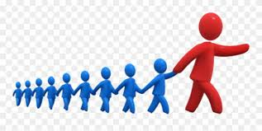
Characteristic of effective leadership
Risk taking
Value in others
Teamwork
Coaching and development
Decision making
Planning

Slide 24
Styles of leadership
Autocratic
Bureaucratic
Democratic
Laissez faire
Servant
People oriented
Neurocratic/ Task oriented
Transactional
Transformational

Slide 25
Team Building
A team is a group of people working towards a common goal.
Stages in team building
Forming
Storming
Norming
Performing
Adjourning or Mourning

Slide 26
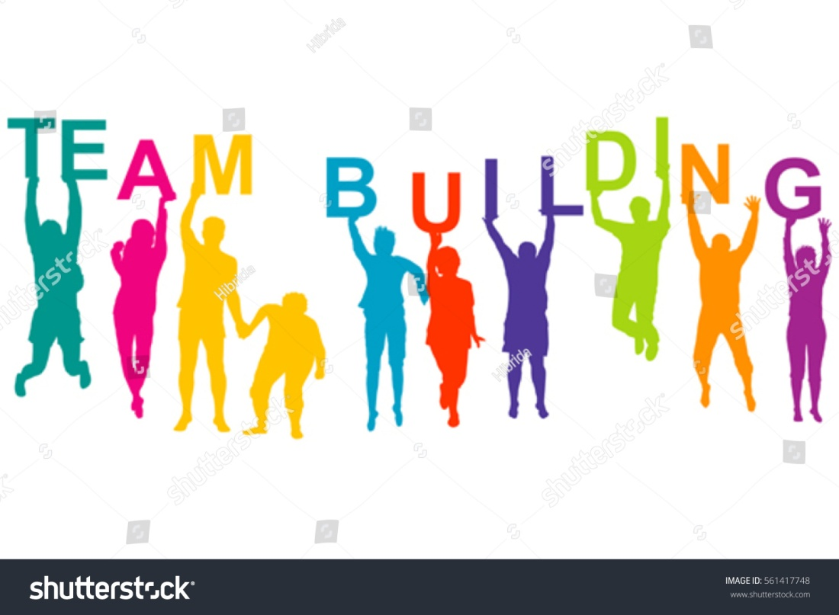
Essentials of effective team building
Good team leader
Understanding and Collaboration
Building trust
Active participation
Effective Communication
Managing Conflict

